Slide 1
IT Professional Environment: Law, Ethics and Privacy
Lecture and Tutorial Week 3:
Dr. Farshid Keivanian

Slide 2
What Are Human Rights?
Fundamental rights inherent to all human beings, regardless of nationality, gender, ethnicity, or religion.
Examples: Right to life, freedom of speech, and equality before the law.

Slide 3
Overview of the Universal Declaration of Human Rights (UDHR)
Adopted by the United Nations General Assembly in 1948.
Contains 30 articles outlining basic rights and freedoms.
Recognized as the foundation for international human rights law.

Slide 4
Why Are Human Rights Important?
Protect individuals from abuse and discrimination.
Ensure fairness and justice in societies.
Examples of global impact:
Protecting refugees.
Addressing gender inequality.

Slide 5
Connecting Human Rights to Modern Issues
Human rights violations are prevalent in conflict zones, where war, displacement, and political unrest lead to abuses like violence, discrimination, and denial of basic needs. International organizations like the Red Cross provide humanitarian aid, while Amnesty International advocates for justice, accountability, and policy reforms to uphold human rights globally.

Slide 6
United Nations Human Rights
Open-ended Question: How do the principles outlined in the Universal Declaration of Human Rights influence national laws and policies today?
Practical Example: The International Red Cross works globally to ensure that human rights, as outlined by the United Nations, are upheld, especially in conflict zones. For example, their work in Syria focuses on providing humanitarian aid and protecting the rights of civilians.

Slide 7
United Nations Human Rights
Class Activity:
Please take a moment to research another international organization that works to uphold human rights and present their findings.

Slide 8
The Role of Technology in Society
Accelerates innovation and communication.
Provides tools for advocacy and social change.
Example: Social media in organizing protests.

Slide 9
Benefits of Technology for Human Rights
Documents abuses with evidence (e.g., videos, photos).
Increases transparency and accountability.
Enhances communication in remote or conflict areas.

Slide 10
Challenges of Technology and Human Rights
Privacy violations (e.g., surveillance).
Spread of misinformation.
Exclusion of marginalized communities from digital access.

Slide 11
Impact of Technology: A Balancing Act
How can technology protect rights while minimizing risks?
Examples of organizations using technology ethically:
Amnesty International: Satellite imagery for evidence collection.

Slide 12
Technology and Human Rights
Open-ended Question: How can advancements in technology both support and hinder human rights?
Practical Example: Amnesty International uses technology to document human rights abuses. For example, they have used satellite imagery to monitor and report on the destruction of villages in conflict areas.

Slide 13
Technology and Human Rights
Class Activity:
Please take a moment to discuss the role of social media in promoting human rights, use examples.

Slide 14
What is Cyberspace?
A digital realm where online communication, transactions, and interactions occur.
Examples: Social media platforms, e-commerce websites, and cloud-based services.

Slide 15
Human Rights in Cyberspace
Right to privacy, freedom of expression, and data protection.
Challenges:
Cyberbullying.
Unauthorized data usage.

Slide 16
Key Issues in Cyberspace
Data breaches and cybersecurity threats.
Censorship and internet shutdowns.
Debates on whether internet access is a fundamental right.

Slide 17
Global Implications
The role of governments, corporations, and civil society in protecting digital rights.
Examples of policies addressing cyberspace rights:
EU's "Right to Be Forgotten."
Cybersecurity initiatives in Australia.

Slide 18
Cyberspace and Human Rights
Open-ended Question: What are the challenges in applying traditional human rights laws to cyberspace?
Practical Example: Google has faced numerous challenges related to human rights in cyberspace, including issues around privacy and data protection. For instance, the "right to be forgotten" ruling in the EU requires Google to remove certain personal information from search results upon request.

Slide 19
Cyberspace and Human Rights
Class Activity:
Please take a moment to debate on whether the internet should be considered a human right, citing examples from different countries.

Slide 20
Digital Rights
Open-ended Question: What are digital rights, and how do they differ from traditional human rights?
Practical Example: The Electronic Frontier Foundation (EFF) advocates for digital rights, such as the right to privacy and free expression online. They have been involved in legal battles to protect users' digital privacy against government surveillance.

Slide 21
Digital Rights
Class Activity:
Please take a moment to find and present a case where digital rights were violated and discuss the outcomes.

Slide 22
Social Networks and Law
Open-ended Question: How do social networks balance the need for free speech with the responsibility to prevent harmful content?
Practical Example: Facebook has faced numerous legal challenges regarding the spread of misinformation and hate speech on its platform. They have implemented various measures to combat these issues, such as fact-checking partnerships and content moderation.

Slide 23
Social Networks and Law
Class Activity:
Please take a moment to discuss the effectiveness of social media policies on free speech and harmful content, using real-world examples.

Slide 24
Robotics and Law
Open-ended Question: What legal and ethical considerations should be taken into account when developing and deploying robots?
Practical Example: Boston Dynamics, known for developing advanced robots like Spot, has to navigate legal and ethical issues related to the deployment of robots in public spaces, including concerns about privacy and security.

Slide 25
Robotics and Law
Class Activity:
Please take a moment to design a set of ethical guidelines for a fictional company developing autonomous delivery drones.

Slide 26
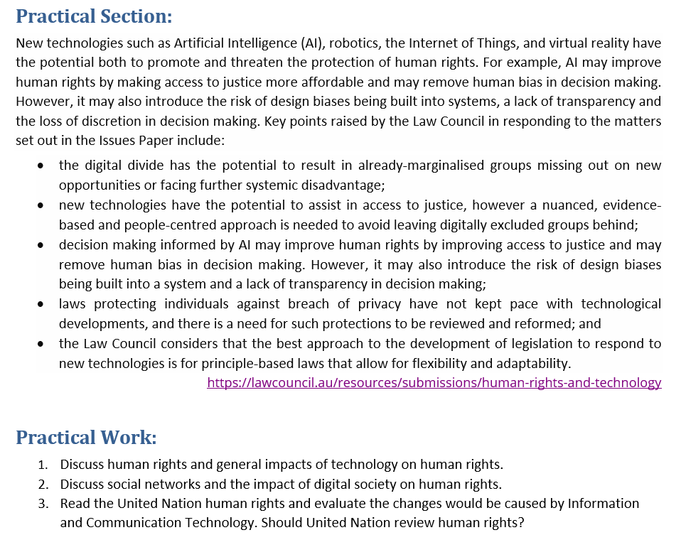
Tutorial Week 3

Slide 27
Tutorial Week 3
1. Discuss human rights and general impacts of technology on human rights.
Human rights encompass fundamental rights and freedoms that every individual is entitled to, such as the right to life, liberty, and personal security. Technology, especially new advancements such as AI, robotics, and the Internet of Things, has significant impacts on these rights.
Positive Impacts:
Access to Justice: AI can enhance access to legal services, making them more affordable and efficient. Automated systems can process legal documents and provide legal advice, reducing the cost and time associated with legal procedures.
Reduction of Bias: AI can help remove human bias in decision-making processes. For instance, in judicial systems, AI algorithms can ensure more consistent and unbiased rulings based on data rather than human prejudices.
Increased Transparency: Blockchain technology can ensure transparency and accountability in various systems, such as voting or supply chains, protecting rights to fair processes and ethical practices.

Slide 28
Tutorial Week 3
Negative Impacts:
Design Biases: AI systems can inherit biases from the data they are trained on, leading to discriminatory outcomes. For instance, biased algorithms in hiring processes can unfairly disadvantage certain groups.
Privacy Concerns: The pervasive nature of digital technologies can lead to significant privacy breaches. Surveillance systems and data collection practices can infringe on individuals' rights to privacy.
Digital Divide: Technological advancements can exacerbate existing inequalities. Marginalized groups may not have the same access to new technologies, leading to further systemic disadvantage.

Slide 29
Tutorial Week 3
2. Discuss social networks and the impact of digital society on human rights.
Social networks and the digital society at large have transformed communication, information dissemination, and social interaction, with profound impacts on human rights:
Positive Impacts:
Freedom of Expression: Social networks provide platforms for individuals to express their opinions, share information, and engage in public discourse. This enhances the right to freedom of expression and access to information.
Social Movements: Digital platforms have been instrumental in mobilizing social movements and advocacy campaigns. They help in organizing protests, raising awareness, and promoting human rights causes globally.

Slide 30
Tutorial Week 3
Negative Impacts:
Misinformation and Hate Speech: The spread of misinformation and hate speech on social networks can incite violence, discrimination, and societal divisions. This challenges the balance between freedom of expression and the protection of other rights.
Privacy Violations: Social networks often collect and misuse personal data. Unauthorized data sharing and breaches can compromise the right to privacy.
Cyberbullying and Harassment: Online platforms can be avenues for cyberbullying and harassment, affecting individuals' mental health and safety. This impacts the right to security and protection from harm.

Slide 31
Tutorial Week 3
3. Read the United Nations human rights and evaluate the changes that would be caused by Information and Communication Technology. Should the United Nations review human rights?
The United Nations Universal Declaration of Human Rights (UDHR) outlines fundamental rights and freedoms that are universally protected. Information and Communication Technology (ICT) can significantly impact these rights, necessitating a review to address emerging challenges and opportunities:
Changes Caused by ICT:
Access to Information: ICT has revolutionized access to information, empowering individuals with knowledge and enabling informed decision-making. This supports the right to education and access to information.
Economic Opportunities: Digital technologies create new economic opportunities and can help reduce poverty by providing access to new markets and services. This impacts the right to an adequate standard of living.
Privacy and Surveillance: The proliferation of digital surveillance technologies poses significant risks to privacy. Governments and corporations can collect vast amounts of personal data, potentially infringing on individuals' rights.

Slide 32
Tutorial Week 3
Need for Review:
Adapting to New Realities: The rapid pace of technological advancement requires that human rights frameworks be continually updated to address new issues such as digital privacy, cybersecurity, and algorithmic bias.
Protecting Vulnerable Populations: A review can ensure that protections are in place for vulnerable populations who may be disproportionately affected by digital exclusion and surveillance.
Balancing Rights: The United Nations can help balance the right to freedom of expression with the need to protect against harm caused by misinformation and hate speech online.

Slide 33
Tutorial Week 3
In conclusion, the United Nations should indeed review and update human rights frameworks to ensure they remain relevant and robust in the face of evolving technological landscapes. This review should focus on safeguarding rights while leveraging technology to promote social good and protect against new forms of harm

